Slide 1
Module 11: IPv4 Addressing
Introduction to Networks v7.0 (ITN)
Notes:
Cisco Networking Academy Program
Introduction to Networks v7.0 (ITN)
Module 11: IPv4 Addressing

Slide 2
11.1 IPv4 Address Structure
Notes:
11 – IPv4 Addressing
11.1 – IPv4 Address Structure

Slide 3
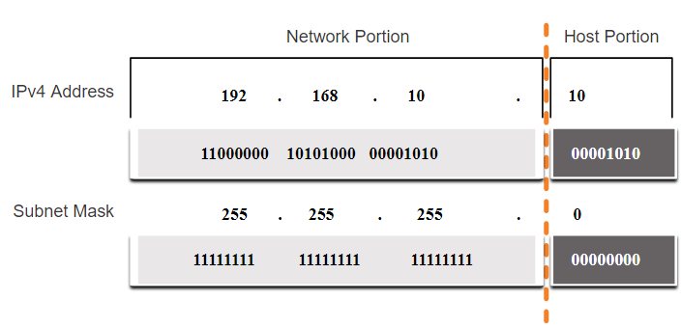
IPv4 Address Structure The Subnet Mask
An IPv4 address is a 32-bit hierarchical address that is made up of a network portion and a host portion.
To identify the network and host portions of an IPv4 address, the subnet mask is compared to the IPv4 address bit for bit, from left to right.
The actual process used to identify the network and host portions is called ANDing.
Notes:
11 – IPv4 Addressing
11.1 – IPv4 Address Structure
11.1.2 – The Subnet Mask

Slide 4
IPv4 Address Structure The Prefix Length
A prefix length is a less cumbersome method used to identify a subnet mask address.
The prefix length is the number of bits set to 1 in the subnet mask.
It is written in “slash notation” therefore, count the number of bits in the subnet mask and prepend it with a slash.
Subnet Mask | 32-bit Address | Prefix Length
255.0.0.0 | 11111111.00000000.00000000.00000000 | /8
255.255.0.0 | 11111111.11111111.00000000.00000000 | /16
255.255.255.0 | 11111111.11111111.11111111.00000000 | /24
255.255.255.128 | 11111111.11111111.11111111.10000000 | /25
255.255.255.192 | 11111111.11111111.11111111.11000000 | /26
255.255.255.224 | 11111111.11111111.11111111.11100000 | /27
255.255.255.240 | 11111111.11111111.11111111.11110000 | /28
255.255.255.248 | 11111111.11111111.11111111.11111000 | /29
255.255.255.252 | 11111111.11111111.11111111.11111100 | /30
Notes:
11 – IPv4 Addressing
11.1 – IPv4 Address Structure
11.1.3 – The Prefix Length

Slide 5
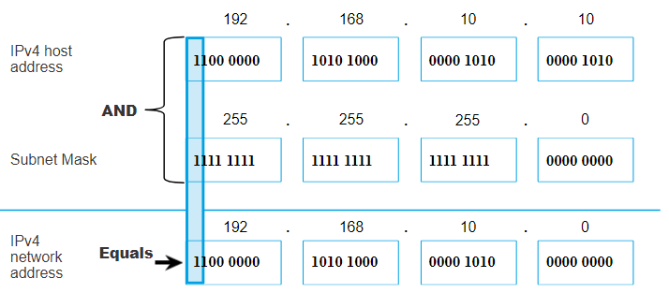
IPv4 Address Structure Determining the Network: Logical AND
A logical AND Boolean operation is used in determining the network address.
Logical AND is the comparison of two bits where only a 1 AND 1 produces a 1 and any other combination results in a 0.
1 AND 1 = 1, 0 AND 1 = 0, 1 AND 0 = 0, 0 AND 0 = 0
1 = True and 0 = False
To identify the network address, the host IPv4 address is logically ANDed, bit by bit, with the subnet mask to identify the network address.
Notes:
11 – IPv4 Addressing
11.1 – IPv4 Address Structure
11.1.4 – Determining the Network: Logical AND

Slide 6
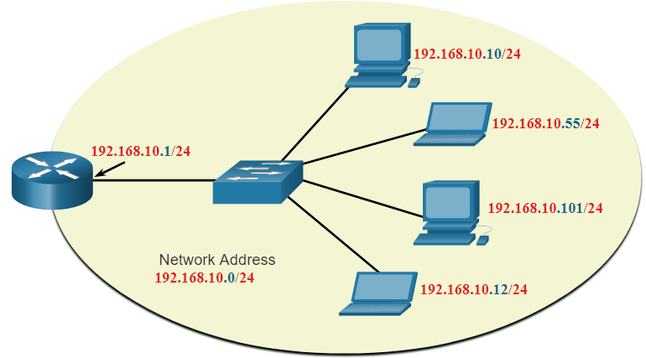
IPv4 Address Structure Network, Host, and Broadcast Addresses
Within each network are three types of IP addresses:
Network address
Host addresses
Broadcast address
 | Network Portion | Host Portion | Host Bits
Subnet mask 255.255.255.0 or /24 | 255 255 255 11111111 11111111 11111111 | 0 00000000
Network address 192.168.10.0 or /24 | 192 168 10 11000000 10100000 00001010 | 0 00000000 | All 0s
First address 192.168.10.1 or /24 | 192 168 10 11000000 10100000 00001010 | 1 00000001 | All 0s and a 1
Last address 192.168.10.254 or /24 | 192 168 10 11000000 10100000 00001010 | 254 11111110 | All 1s and a 0
Broadcast address 192.168.10.255 or /24 | 192 168 10 11000000 10100000 00001010 | 255 11111111 | All 1s
Notes:
11 – IPv4 Addressing
11.1 – IPv4 Address Structure
11.1.6 – Network, Host, and Broadcast Addresses
11.1.7 – Activity – ANDing to Determine the Network Address
11.1.8 – Check Your Understanding - IPv4 Address Structure

Slide 7
11.2 IPv4 Unicast, Broadcast, and Multicast
Notes:
11 – IPv4 Addressing
11.2 – IPv4 Unicast, Broadcast, and Multicast

Slide 8
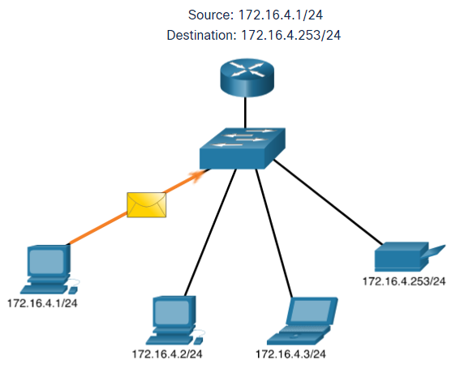
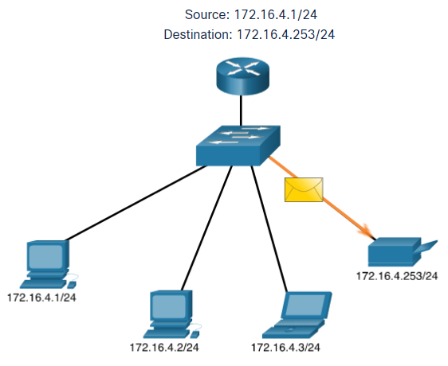
IPv4 Unicast, Broadcast, and Multicast Unicast
Unicast transmission is sending a packet to one destination IP address.
For example, the PC at 172.16.4.1 sends a unicast packet to the printer at 172.16.4.253.
Notes:
11 – IPv4 Addressing
11.2 – IPv4 Unicast, Broadcast, and Multicast
11.2.1 – Unicast

Slide 9
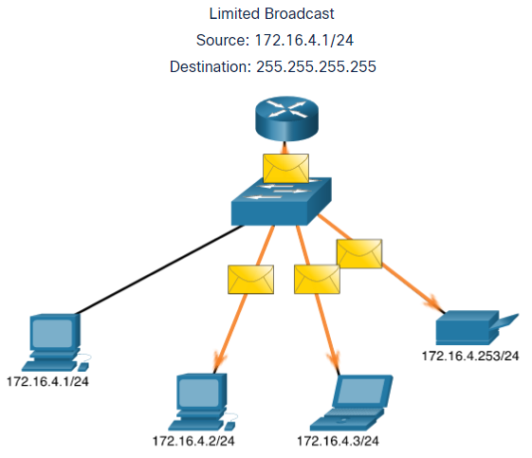
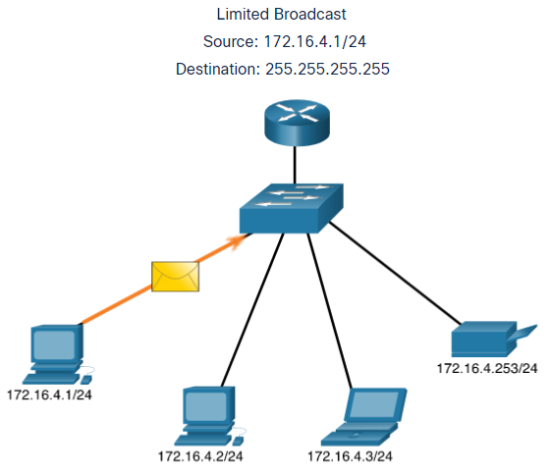
IPv4 Unicast, Broadcast, and Multicast Broadcast
Broadcast transmission is sending a packet to all other destination IP addresses.
For example, the PC at 172.16.4.1 sends a broadcast packet to all IPv4 hosts.
Notes:
11 – IPv4 Addressing
11.2 – IPv4 Unicast, Broadcast, and Multicast
11.2.2 – Broadcast

Slide 10
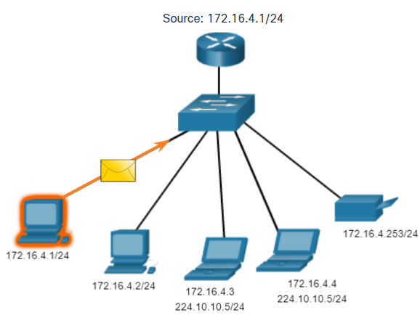
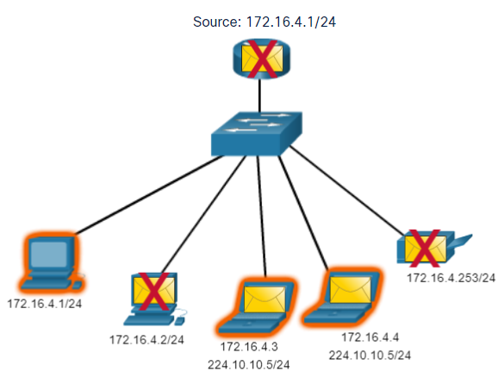
IPv4 Unicast, Broadcast, and Multicast Multicast
Multicast transmission is sending a packet to a multicast address group.
For example, the PC at 172.16.4.1 sends a multicast packet to the multicast group address 224.10.10.5.
Notes:
11 – IPv4 Addressing
11.2 – IPv4 Unicast, Broadcast, and Multicast
11.2.3 – Multicast
11.2.4 – Activity - Unicast, Broadcast, or Multicast

Slide 11
11.3 Types of IPv4 Addresses
Notes:
11 – IPv4 Addressing
11.3 – Types of IPv4 Addresses

Slide 12
Types of IPv4 Addresses Public and Private IPv4 Addresses
As defined in in RFC 1918, public IPv4 addresses are globally routed between internet service provider (ISP) routers.
However, private addresses are not globally routable.
Private addresses are common blocks of addresses used by most organizations to assign IPv4 addresses to internal hosts.
Private IPv4 addresses are not unique and can be used internally within any network.
Network Address and Prefix | RFC 1918 Private Address Range
10.0.0.0/8 | 10.0.0.0 - 10.255.255.255
172.16.0.0/12 | 172.16.0.0 - 172.31.255.255
192.168.0.0/16 | 192.168.0.0 - 192.168.255.255
Notes:
11 – IPv4 Addressing
11.3 – Types of IPv4 Addresses
11.3.1 – Public and Private IPv4 Addresses

Slide 13
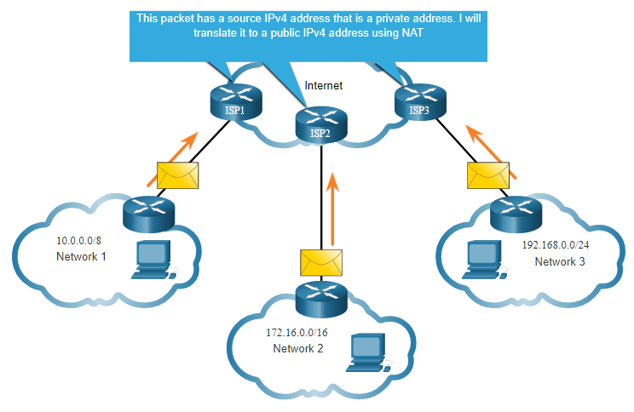
Types of IPv4 Addresses Routing to the Internet
Network Address Translation (NAT) translates private IPv4 addresses to public IPv4 addresses.
NAT is typically enabled on the edge router connecting to the internet.
It translates the internal private address to a public global IP address.
Notes:
11 – IPv4 Addressing
11.3 – Types of IPv4 Addresses
11.3.2 – Routing to the Internet
11.3.3 – Activity - Pass or Block IPv4 Addresses

Slide 14
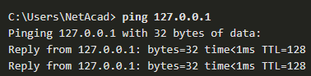
Types of IPv4 Addresses Special Use IPv4 Addresses
Loopback addresses
127.0.0.0 /8 (127.0.0.1 to 127.255.255.254)
Commonly identified as only 127.0.0.1
Used on a host to test if TCP/IP is operational.
Link-Local addresses
169.254.0.0 /16 (169.254.0.1 to 169.254.255.254)
Commonly known as the Automatic Private IP Addressing (APIPA) addresses or self-assigned addresses.
Used by Windows DHCP clients to self-configure when no DHCP servers are available.
Notes:
11 – IPv4 Addressing
11.3 – Types of IPv4 Addresses
11.3.4 – Special Use IPv4 Addresses

Slide 15
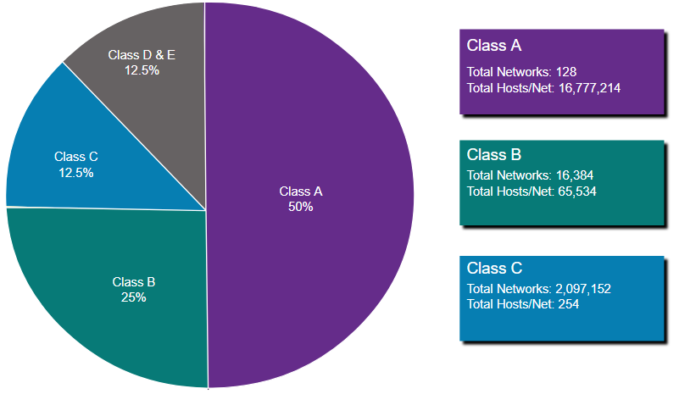
Types of IPv4 Addresses Legacy Classful Addressing
RFC 790 (1981) allocated IPv4 addresses in classes
Class A (0.0.0.0/8 to 127.0.0.0/8)
Class B (128.0.0.0 /16 – 191.255.0.0 /16)
Class C (192.0.0.0 /24 – 223.255.255.0 /24)
Class D (224.0.0.0 to 239.0.0.0)
Class E (240.0.0.0 – 255.0.0.0)
Classful addressing wasted many IPv4 addresses.
Classful address allocation was replaced with classless addressing which ignores the rules of classes (A, B, C).
Notes:
11 – IPv4 Addressing
11.3 – Types of IPv4 Addresses
11.3.5 – Legacy Classful Addressing

Slide 16
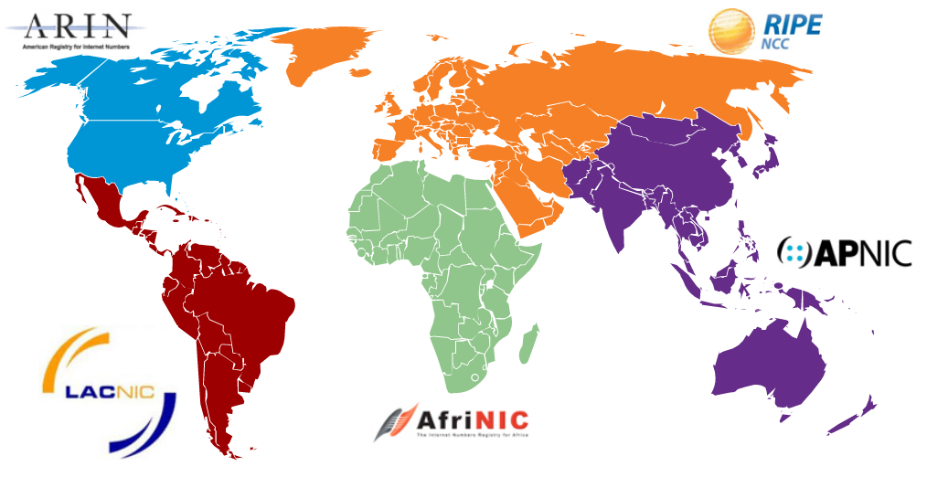
Types of IPv4 Addresses Assignment of IP Addresses
The Internet Assigned Numbers Authority (IANA) manages and allocates blocks of IPv4 and IPv6 addresses to five Regional Internet Registries (RIRs).
RIRs are responsible for allocating IP addresses to ISPs who provide IPv4 address blocks to smaller ISPs and organizations.
Notes:
11 – IPv4 Addressing
11.3 – Types of IPv4 Addresses
11.3.6 – Assignment of IP Addresses
11.3.7 – Activity - Public or Private IPv4 Address
11.3.8 – Check Your Understanding - Types of IPv4 Addresses

Slide 17
11.4 Network Segmentation
Notes:
11 – IPv4 Addressing
11.4 – Network Segmentation

Slide 18
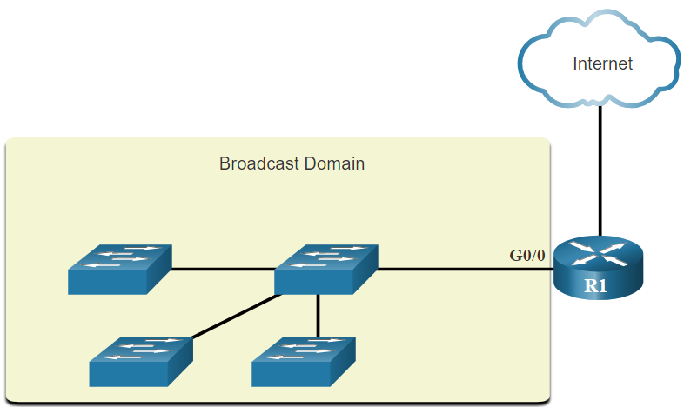
Network Segmentation Broadcast Domains and Segmentation
Many protocols use broadcasts or multicasts (e.g., ARP use broadcasts to locate other devices, hosts send DHCP discover broadcasts to locate a DHCP server.)
Switches propagate broadcasts out all interfaces except the interface on which it was received.
The only device that stops broadcasts is a router.
Routers do not propagate broadcasts.
Each router interface connects to a broadcast domain and broadcasts are only propagated within that specific broadcast domain.
Notes:
11 – IPv4 Addressing
11.4 – Network Segmentation
11.4.1 – Broadcast Domains and Segmentation

Slide 19
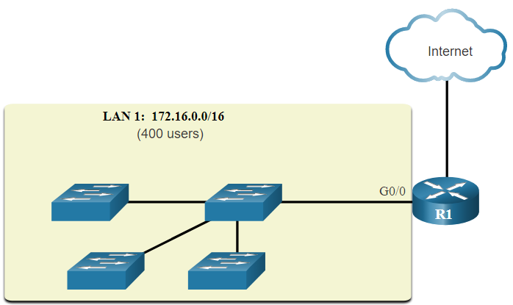
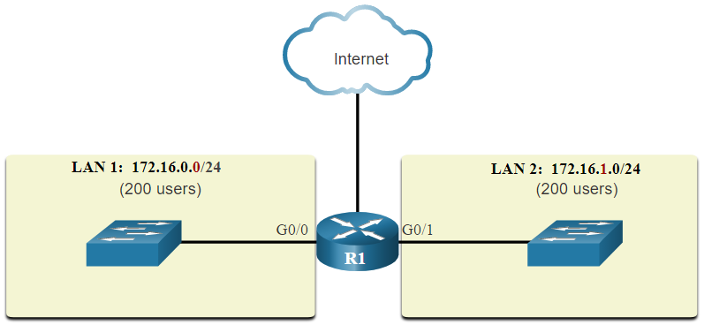
Network Segmentation Problems with Large Broadcast Domains
A problem with a large broadcast domain is that these hosts can generate excessive broadcasts and negatively affect the network.
The solution is to reduce the size of the network to create smaller broadcast domains in a process called subnetting.
Dividing the network address 172.16.0.0 /16 into two subnets of 200 users each: 172.16.0.0 /24 and 172.16.1.0 /24.
Broadcasts are only propagated within the smaller broadcast domains.
Notes:
11 – IPv4 Addressing
11.4 – Network Segmentation
11.4.2 – Problems with Large Broadcast Domains

Slide 20
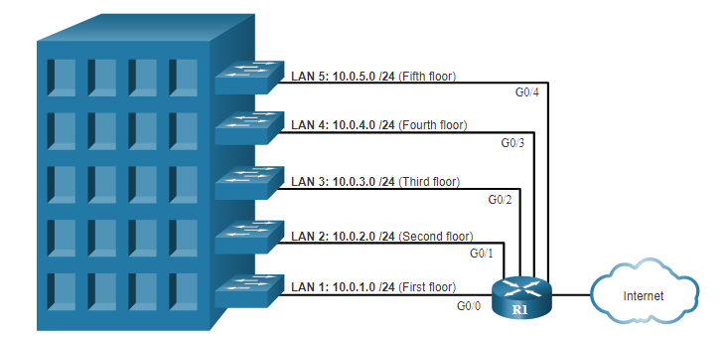
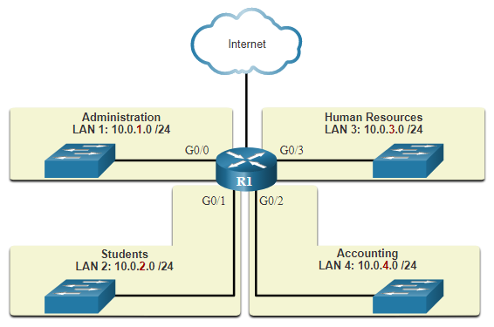
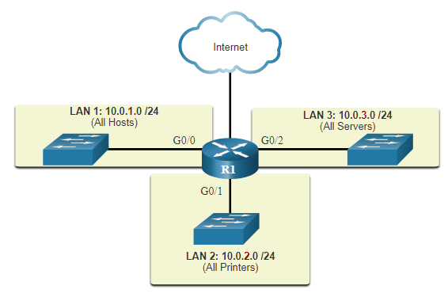
Network Segmentation Reasons for Segmenting Networks
Subnetting reduces overall network traffic and improves network performance.
It can be used to implement security policies between subnets.
Subnetting reduces the number of devices affected by abnormal broadcast traffic.
Subnets are used for a variety of reasons including by:
Location
Group or Function
Device Type
Notes:
11 – IPv4 Addressing
11.4 – Network Segmentation
11.4.3 – Reasons for Segmenting Networks
11.4.4 – Check Your Understanding - Network Segmentation

Slide 21
11.5 Subnet an IPv4 Network
Notes:
11 – IPv4 Addressing
11.5 – Subnet an IPv4 Network

Slide 22
Subnet an IPv4 Network Subnet on an Octet Boundary
Networks are most easily subnetted at the octet boundary of /8, /16, and /24.
Notice that using longer prefix lengths decreases the number of hosts per subnet.
Prefix Length | Subnet Mask | Subnet Mask in Binary (n = network, h = host) | # of hosts
/8 | 255.0.0.0 | nnnnnnnn.hhhhhhhh.hhhhhhhh.hhhhhhhh 11111111.00000000.00000000.00000000 | 16,777,214
/16 | 255.255.0.0 | nnnnnnnn.nnnnnnnn.hhhhhhhh.hhhhhhhh 11111111.11111111.00000000.00000000 | 65,534
/24 | 255.255.255.0 | nnnnnnnn.nnnnnnnn.nnnnnnnn.hhhhhhhh 11111111.11111111.11111111.00000000 | 254
Notes:
11 – IPv4 Addressing
11.5 – Subnet an IPv4 Network
11.5.1 – Subnet on an Octet Boundary

Slide 23
Subnet an IPv4 Network Subnet on an Octet Boundary (Cont.)
In the first table 10.0.0.0/8 is subnetted using /16 and in the second table, a /24 mask.
Subnet Address (256 Possible Subnets) | Host Range (65,534 possible hosts per subnet) | Broadcast
10.0.0.0/16 | 10.0.0.1 - 10.0.255.254 | 10.0.255.255
10.1.0.0/16 | 10.1.0.1 - 10.1.255.254 | 10.1.255.255
10.2.0.0/16 | 10.2.0.1 - 10.2.255.254 | 10.2.255.255
10.3.0.0/16 | 10.3.0.1 - 10.3.255.254 | 10.3.255.255
10.4.0.0/16 | 10.4.0.1 - 10.4.255.254 | 10.4.255.255
10.5.0.0/16 | 10.5.0.1 - 10.5.255.254 | 10.5.255.255
10.6.0.0/16 | 10.6.0.1 - 10.6.255.254 | 10.6.255.255
10.7.0.0/16 | 10.7.0.1 - 10.7.255.254 | 10.7.255.255
... | ... | ...
10.255.0.0/16 | 10.255.0.1 - 10.255.255.254 | 10.255.255.255
Subnet Address (65,536 Possible Subnets) | Host Range (254 possible hosts per subnet) | Broadcast
10.0.0.0/24 | 10.0.0.1 - 10.0.0.254 | 10.0.0.255
10.0.1.0/24 | 10.0.1.1 - 10.0.1.254 | 10.0.1.255
10.0.2.0/24 | 10.0.2.1 - 10.0.2.254 | 10.0.2.255
… | … | …
10.0.255.0/24 | 10.0.255.1 - 10.0.255.254 | 10.0.255.255
10.1.0.0/24 | 10.1.0.1 - 10.1.0.254 | 10.1.0.255
10.1.1.0/24 | 10.1.1.1 - 10.1.1.254 | 10.1.1.255
10.1.2.0/24 | 10.1.2.1 - 10.1.2.254 | 10.1.2.255
… | … | …
10.100.0.0/24 | 10.100.0.1 - 10.100.0.254 | 10.100.0.255
... | ... | ...
10.255.255.0/24 | 10.255.255.1 - 10.255.255.254 | 10.255.255.255
Notes:
11 – IPv4 Addressing
11.5 – Subnet an IPv4 Network
11.5.1 – Subnet on an Octet Boundary (Cont.)

Slide 24
Subnet an IPv4 Network Subnet within an Octet Boundary
Refer to the table to see six ways to subnet a /24 network.
Prefix Length | Subnet Mask | Subnet Mask in Binary (n = network, h = host) | # of subnets | # of hosts
/25 | 255.255.255.128 | nnnnnnnn.nnnnnnnn.nnnnnnnn.nhhhhhhh 11111111.11111111.11111111.10000000 | 2 | 126
/26 | 255.255.255.192 | nnnnnnnn.nnnnnnnn.nnnnnnnn.nnhhhhhh 11111111.11111111.11111111.11000000 | 4 | 62
/27 | 255.255.255.224 | nnnnnnnn.nnnnnnnn.nnnnnnnn.nnnhhhhh 11111111.11111111.11111111.11100000 | 8 | 30
/28 | 255.255.255.240 | nnnnnnnn.nnnnnnnn.nnnnnnnn.nnnnhhhh 11111111.11111111.11111111.11110000 | 16 | 14
/29 | 255.255.255.248 | nnnnnnnn.nnnnnnnn.nnnnnnnn.nnnnnhhh 11111111.11111111.11111111.11111000 | 32 | 6
/30 | 255.255.255.252 | nnnnnnnn.nnnnnnnn.nnnnnnnn.nnnnnnhh 11111111.11111111.11111111.11111100 | 64 | 2
Network 192.168.1.0/25 host 192.168.1.1-126 bc 192.168.1.127
Network 192.168.1.128/25 host 192.168.1.129-254 bc 192.168.1.255
Notes:
11 – IPv4 Addressing
11.5 – Subnet an IPv4 Network
11.5.2 – Subnet within an Octet Boundary

Slide 25
11.6 Subnet a Slash 16 and a Slash 8 Prefix
Notes:
11 – IPv4 Addressing
11.6 – Subnet a Slash 16 and a Slash 8 Prefix

Slide 26
Subnet a Slash 16 and a Slash 8 Prefix Create Subnets with a Slash 16 prefix
Prefix Length | Subnet Mask | Network Address (n = network, h = host) | # of subnets | # of hosts
/17 | 255.255.128.0 | nnnnnnnn.nnnnnnnn.nhhhhhhh.hhhhhhhh 11111111.11111111.10000000.00000000 | 2 | 32766
/18 | 255.255.192.0 | nnnnnnnn.nnnnnnnn.nnhhhhhh.hhhhhhhh 11111111.11111111.11000000.00000000 | 4 | 16382
/19 | 255.255.224.0 | nnnnnnnn.nnnnnnnn.nnnhhhhh.hhhhhhhh 11111111.11111111.11100000.00000000 | 8 | 8190
/20 | 255.255.240.0 | nnnnnnnn.nnnnnnnn.nnnnhhhh.hhhhhhhh 11111111.11111111.11110000.00000000 | 16 | 4094
/21 | 255.255.248.0 | nnnnnnnn.nnnnnnnn.nnnnnhhh.hhhhhhhh 11111111.11111111.11111000.00000000 | 32 | 2046
/22 | 255.255.252.0 | nnnnnnnn.nnnnnnnn.nnnnnnhh.hhhhhhhh 11111111.11111111.11111100.00000000 | 64 | 1022
/23 | 255.255.254.0 | nnnnnnnn.nnnnnnnn.nnnnnnnh.hhhhhhhh 11111111.11111111.11111110.00000000 | 128 | 510
/24 | 255.255.255.0 | nnnnnnnn.nnnnnnnn.nnnnnnnn.hhhhhhhh 11111111.11111111.11111111.00000000 | 256 | 254
/25 | 255.255.255.128 | nnnnnnnn.nnnnnnnn.nnnnnnnn.nhhhhhhh 11111111.11111111.11111111.10000000 | 512 | 126
/26 | 255.255.255.192 | nnnnnnnn.nnnnnnnn.nnnnnnnn.nnhhhhhh 11111111.11111111.11111111.11000000 | 1024 | 62
/27 | 255.255.255.224 | nnnnnnnn.nnnnnnnn.nnnnnnnn.nnnhhhhh 11111111.11111111.11111111.11100000 | 2048 | 30
/28 | 255.255.255.240 | nnnnnnnn.nnnnnnnn.nnnnnnnn.nnnnhhhh 11111111.11111111.11111111.11110000 | 4096 | 14
/29 | 255.255.255.248 | nnnnnnnn.nnnnnnnn.nnnnnnnn.nnnnnhhh 11111111.11111111.11111111.11111000 | 8192 | 6
/30 | 255.255.255.252 | nnnnnnnn.nnnnnnnn.nnnnnnnn.nnnnnnhh 11111111.11111111.11111111.11111100 | 16384 | 2
The table highlights all the possible scenarios for subnetting a /16 prefix.
Notes:
11 – IPv4 Addressing
11.6 – Subnet a Slash 16 and a Slash 8 Prefix
11.6.1 – Create Subnets with a Slash 16 prefix

Slide 27
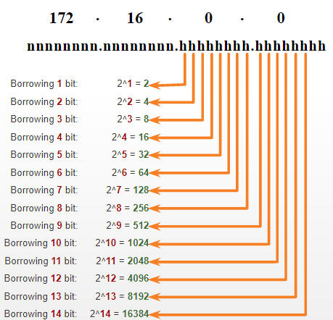
Subnet a Slash 16 and a Slash 8 Prefix Create 100 Subnets with a Slash 16 prefix
Consider a large enterprise that requires at least 100 subnets and has chosen the private address 172.16.0.0/16 as its internal network address.
The figure displays the number of subnets that can be created when borrowing bits from the third octet and the fourth octet.
Notice there are now up to 14 host bits that can be borrowed (i.e., last two bits cannot be borrowed).
To satisfy the requirement of 100 subnets for the enterprise, 7 bits (i.e., 2⁷ = 128 subnets) would need to be borrowed (for a total of 128 subnets).
Notes:
11 – IPv4 Addressing
11.6 – Subnet a Slash 16 and a Slash 8 Prefix
11.6.2 – Create 100 Subnets with a Slash 16 prefix

Slide 28
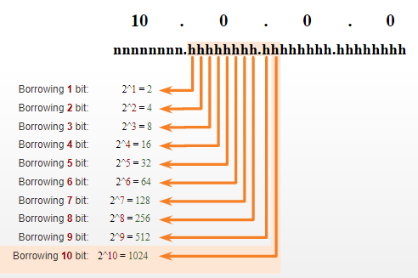
Subnet a Slash 16 and a Slash 8 Prefix Create 1000 Subnets with a Slash 8 prefix
Consider a small ISP that requires 1000 subnets for its clients using network address 10.0.0.0/8 which means there are 8 bits in the network portion and 24 host bits available to borrow toward subnetting.
The figure displays the number of subnets that can be created when borrowing bits from the second and third.
Notice there are now up to 22 host bits that can be borrowed (i.e., last two bits cannot be borrowed).
To satisfy the requirement of 1000 subnets for the enterprise, 10 bits (i.e., 2¹⁰=1024 subnets) would need to be borrowed (for a total of 128 subnets)
Notes:
11 – IPv4 Addressing
11.6 – Subnet a Slash 16 and a Slash 8 Prefix
11.6.3 – Create 1000 Subnets with a Slash 8 prefix

Slide 29
11.7 Subnet to Meet Requirements
Notes:
11 – IPv4 Addressing
11.7 – Subnet to Meet Requirements

Slide 30
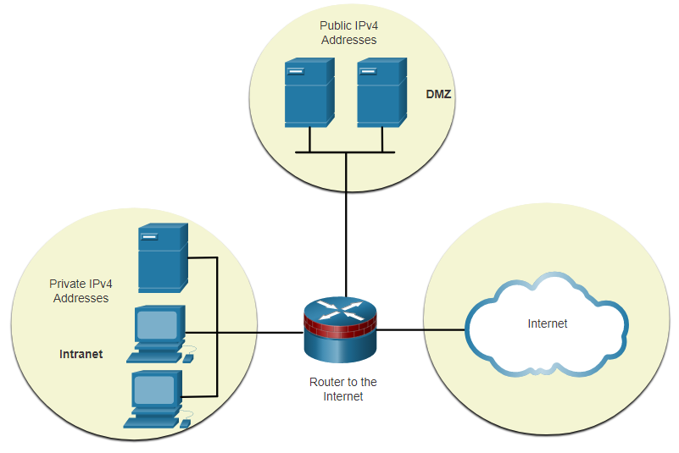
Subnet to Meet Requirements Subnet Private versus Public IPv4 Address Space
Enterprise networks will have an:
Intranet - A company’s internal network typically using private IPv4 addresses.
DMZ – A companies internet facing servers. Devices in the DMZ use public IPv4 addresses.
A company could use the 10.0.0.0/8 and subnet on the /16 or /24 network boundary.
The DMZ devices would have to be configured with public IP addresses.
Notes:
11 – IPv4 Addressing
11.7 – Subnet to Meet Requirements
11.7.1 – Subnet Private versus Public IPv4 Address Space

Slide 31
Subnet to Meet Requirements Minimize Unused Host IPv4 Addresses and Maximize Subnets
There are two considerations when planning subnets:
The number of host addresses required for each network
The number of individual subnets needed
Prefix Length | Subnet Mask | Subnet Mask in Binary (n = network, h = host) | # of subnets | # of hosts
/25 | 255.255.255.128 | nnnnnnnn.nnnnnnnn.nnnnnnnn.nhhhhhhh 11111111.11111111.11111111.10000000 | 2 | 126
/26 | 255.255.255.192 | nnnnnnnn.nnnnnnnn.nnnnnnnn.nnhhhhhh 11111111.11111111.11111111.11000000 | 4 | 62
/27 | 255.255.255.224 | nnnnnnnn.nnnnnnnn.nnnnnnnn.nnnhhhhh 11111111.11111111.11111111.11100000 | 8 | 30
/28 | 255.255.255.240 | nnnnnnnn.nnnnnnnn.nnnnnnnn.nnnnhhhh 11111111.11111111.11111111.11110000 | 16 | 14
/29 | 255.255.255.248 | nnnnnnnn.nnnnnnnn.nnnnnnnn.nnnnnhhh 11111111.11111111.11111111.11111000 | 32 | 6
/30 | 255.255.255.252 | nnnnnnnn.nnnnnnnn.nnnnnnnn.nnnnnnhh 11111111.11111111.11111111.11111100 | 64 | 2
Notes:
11 – IPv4 Addressing
11.7 – Subnet to Meet Requirements
11.7.2 – Minimize Unused Host IPv4 Addresses and Maximize Subnets

Slide 32
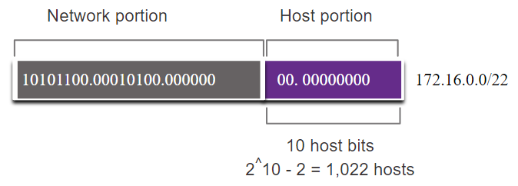
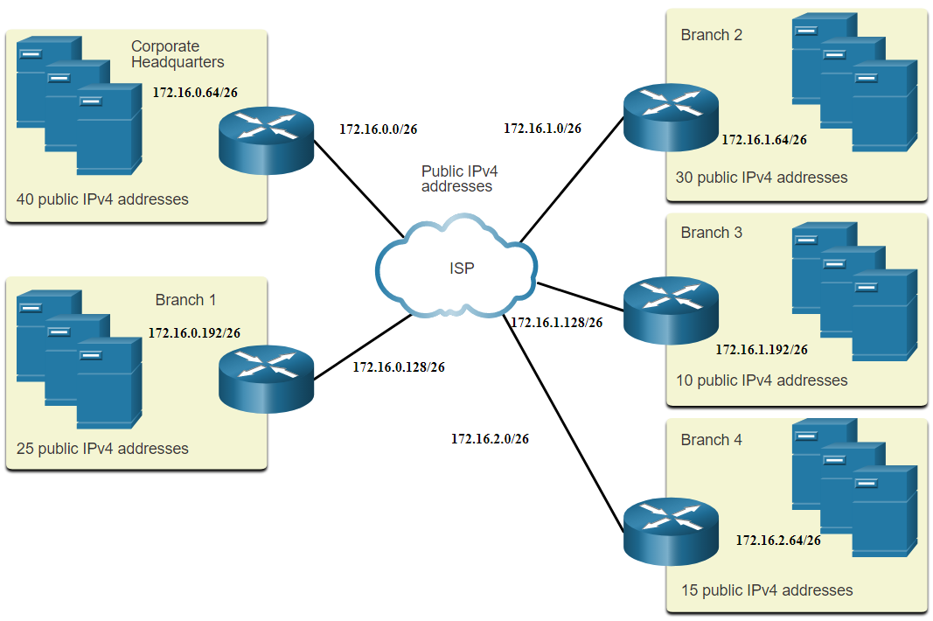
Subnet to Meet Requirements Example: Efficient IPv4 Subnetting
In this example, corporate headquarters has been allocated a public network address of 172.16.0.0/22 (10 host bits) by its ISP providing 1,022 host addresses.
There are five sites and therefore five internet connections which means the organization requires 10 subnets with the largest subnet requires 40 addresses.
It allocated 10 subnets with a /26 (i.e., 255.255.255.192) subnet mask.
Notes:
11 – IPv4 Addressing
11.7 – Subnet to Meet Requirements
11.7.3 – Example: Efficient IPv4 Subnetting
11.7.4 – Activity - Determine the Number of Bits to Borrow

Slide 33
11.8 VLSM
Notes:
11 – IPv4 Addressing
11.8 – VLSM

Slide 34
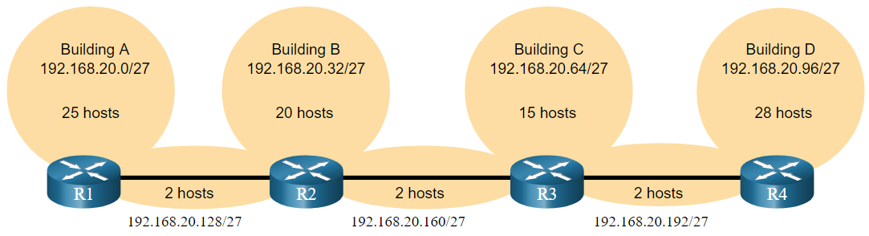
VLSM IPv4 Address Conservation
Given the topology, 7 subnets are required (i.e, four LANs and three WAN links) and the largest number of host is in Building D with 28 hosts.
A /27 mask would provide 8 subnets of 30 host IP addresses and therefore support this topology.
Notes:
11 – IPv4 Addressing
11.8 – VLSM
11.8.3 – IPv4 Address Conservation

Slide 35
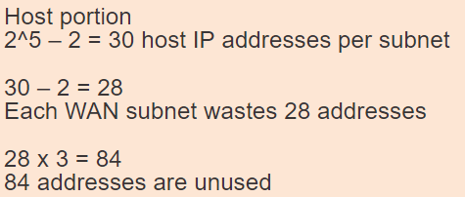
VLSM IPv4 Address Conservation (Cont.)
However, the point-to-point WAN links only require two addresses and therefore waste 28 addresses each for a total of 84 unused addresses.
Applying a traditional subnetting scheme to this scenario is not very efficient and is wasteful.
VLSM was developed to avoid wasting addresses by enabling us to subnet a subnet.
Notes:
11 – IPv4 Addressing
11.8 – VLSM
11.8.3 – IPv4 Address Conservation

Slide 36
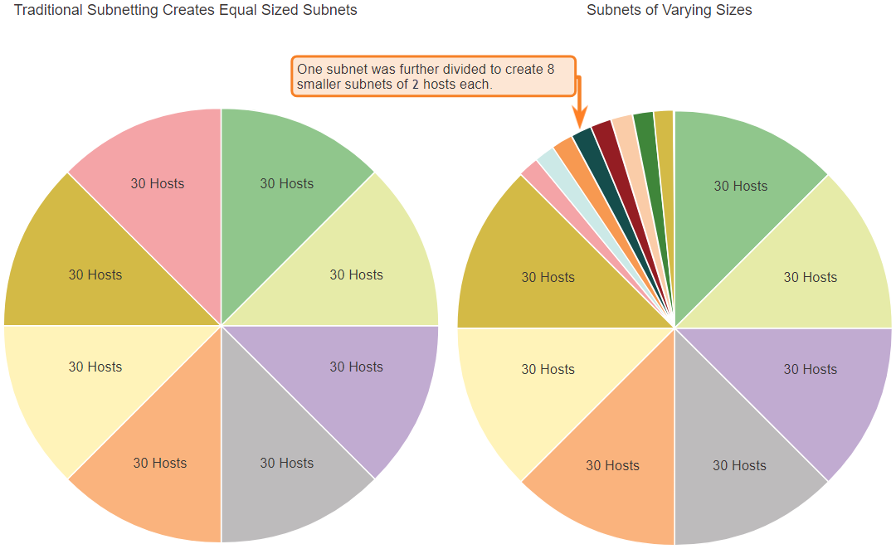
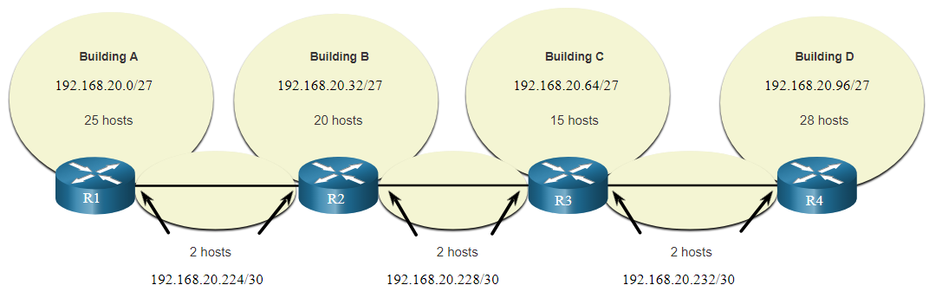
VLSM VLSM
The left side displays the traditional subnetting scheme (i.e., the same subnet mask) while the right side illustrates how VLSM can be used to subnet a subnet and divided the last subnet into eight /30 subnets.
When using VLSM, always begin by satisfying the host requirements of the largest subnet and continue subnetting until the host requirements of the smallest subnet are satisfied.
The resulting topology with VLSM applied.
Notes:
11 – IPv4 Addressing
11.8 – VLSM
11.8.4 – VLSM

Slide 37
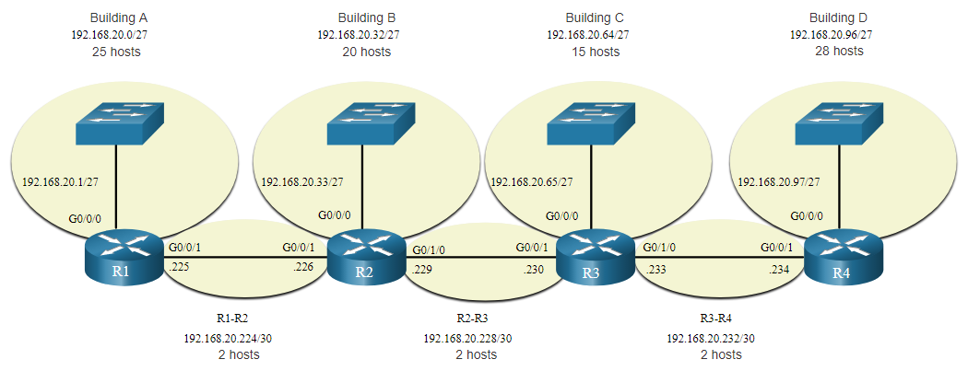
VLSM VLSM Topology Address Assignment
Using VLSM subnets, the LAN and inter-router networks can be addressed without unnecessary waste as shown in the logical topology diagram.
Notes:
11 – IPv4 Addressing
11.8 – VLSM
11.8.5 – VLSM Topology Address Assignment
11.8.6 – Activity - VLSM Practice

Slide 38
11.9 Structured Design
Notes:
11 – IPv4 Addressing
11.9 – Structured Design

Slide 39
Structured Design IPv4 Network Address Planning
IP network planning is crucial to develop a scalable solution to an enterprise network.
To develop an IPv4 network wide addressing scheme, you need to know how many subnets are needed, how many hosts a particular subnet requires, what devices are part of the subnet, which parts of your network use private addresses, and which use public, and many other determining factors.
Examine the needs of an organization’s network usage and how the subnets will be structured.
Perform a network requirement study by looking at the entire network to determining how each area will be segmented.
Determine how many subnets are needed and how many hosts per subnet.
Determine DHCP address pools and Layer 2 VLAN pools.
Notes:
11 – IPv4 Addressing
11.9 – Structured Design
11.9.1 – IPv4 Network Address Planning

Slide 40
Structured Design Device Address Assignment
Within a network, there are different types of devices that require addresses:
End user clients – Most use DHCP to reduce errors and burden on network support staff. IPv6 clients can obtain address information using DHCPv6 or SLAAC.
Servers and peripherals – These should have a predictable static IP address.
Servers that are accessible from the internet – Servers must have a public IPv4 address, most often accessed using NAT.
Intermediary devices – Devices are assigned addresses for network management, monitoring, and security.
Gateway – Routers and firewall devices are gateway for the hosts in that network.
When developing an IP addressing scheme, it is generally recommended that you have a set pattern of how addresses are allocated to each type of device.
Notes:
11 – IPv4 Addressing
11.9 – Structured Design
11.9.2 – Device Address Assignment

Slide 41
Module 12: IPv6 Addressing
Introduction to Networks v7.0 (ITN)
Notes:
Cisco Networking Academy Program
Introduction to Networks v7.0 (ITN)
Module 12: IPv6 Addressing

Slide 42
12.1 IPv4 Issues
Notes:
12-IPv6 Addressing
12.1 IPv4 Issues

Slide 43
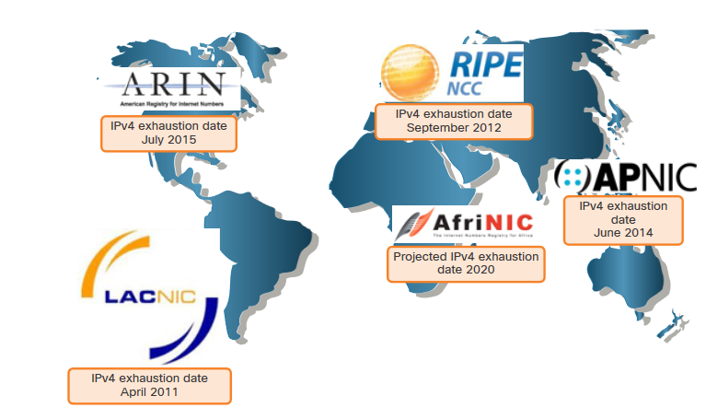
IPv4 Issues Need for IPv6
IPv4 is running out of addresses. IPv6 is the successor to IPv4. IPv6 has a much larger 128-bit address space.
The development of IPv6 also included fixes for IPv4 limitations and other enhancements.
With an increasing internet population, a limited IPv4 address space, issues with NAT and the IoT, the time has come to begin the transition to IPv6.
Notes:
12 – IPv6 Addressing
12.1 – IPv4 Issues
12.1.1 – Need for IPv6

Slide 44
IPv4 Issues IPv4 and IPv6 Coexistence
Both IPv4 and IPv6 will coexist in the near future and the transition will take several years.
The IETF has created various protocols and tools to help network administrators migrate their networks to IPv6. These migration techniques can be divided into three categories:
Dual stack -The devices run both IPv4 and IPv6 protocol stacks simultaneously.
Tunneling – A method of transporting an IPv6 packet over an IPv4 network. The IPv6 packet is encapsulated inside an IPv4 packet.
Translation - Network Address Translation 64 (NAT64) allows IPv6-enabled devices to communicate with IPv4-enabled devices using a translation technique similar to NAT for IPv4.
Note: Tunneling and translation are for transitioning to native IPv6 and should only be used where needed. The goal should be native IPv6 communications from source to destination.
Notes:
12 – IPv6 Addressing
12.1 – IPv4 Issues
12.1.2 – IPv4 and IPv6 Coexistence
12.1.3 – Check Your Understanding – IPv4 Issues

Slide 45
12.2 IPv6 Address Representation
Notes:
12-IPv6 Addressing
12.2 IPv4 Address Representation

Slide 46
IPv6 Address Representation IPv6 Addressing Formats
IPv6 addresses are 128 bits in length and written in hexadecimal.
IPv6 addresses are not case-sensitive and can be written in either lowercase or uppercase.
The preferred format for writing an IPv6 address is x:x:x:x:x:x:x:x, with each “x” consisting of four hexadecimal values.
In IPv6, a hextet is the unofficial term used to refer to a segment of 16 bits, or four hexadecimal values.
Examples of IPv6 addresses in the preferred format:
2001:0db8:0000:1111:0000:0000:0000:0200
2001:0db8:0000:00a3:abcd:0000:0000:1234
Notes:
12 – IPv6 Addressing
12.2 – IPv6 Address Representation
12.2.1 – IPv6 Addressing Formats

Slide 47
IPv6 Address Representation Rule 1 – Omit Leading Zero
The first rule to help reduce the notation of IPv6 addresses is to omit any leading 0s (zeros).
Examples:
01ab can be represented as 1ab
09f0 can be represented as 9f0
0a00 can be represented as a00
00ab can be represented as ab
Note: This rule only applies to leading 0s, NOT to trailing 0s, otherwise the address would be ambiguous.
Type | Format
Preferred | 2001 : 0db8 : 0000 : 1111 : 0000 : 0000 : 0000 : 0200
No leading zeros | 2001 : db8 : 0 : 1111 : 0 : 0 : 0 : 200
Notes:
12 – IPv6 Addressing
12.2 – IPv6 Address Representation
12.2.2 – Omit Leading Zero

Slide 48
IPv6 Address Representation Rule 2 – Double Colon
A double colon (::) can replace any single, contiguous string of one or more 16-bit hextets consisting of all zeros.
Example:
2001:db8:cafe:1:0:0:0:1 (leading 0s omitted) could be represented as 2001:db8:cafe:1::1
Note: The double colon (::) can only be used once within an address, otherwise there would be more than one possible resulting address.
Type | Format
Preferred | 2001 : 0db8 : 0000 : 1111 : 0000 : 0000 : 0000 : 0200
Compressed | 2001:db8:0:1111::200
Notes:
12 – IPv6 Addressing
12.2 – IPv6 Address Representation
12.2.2 – Rule 2 – Double Colon
12.2.4 – Activity – IPv6 Address Representation

Slide 49
12.3 IPv6 Address Types
Notes:
12-IPv6 Addressing
12.2 IPv4 Address Types

Slide 50
IPv6 Address Types Unicast, Multicast, Anycast
There are three broad categories of IPv6 addresses:
Unicast – Unicast uniquely identifies an interface on an IPv6-enabled device.
Multicast – Multicast is used to send a single IPv6 packet to multiple destinations.
Anycast – This is any IPv6 unicast address that can be assigned to multiple devices. A packet sent to an anycast address is routed to the nearest device having that address.
Note: Unlike IPv4, IPv6 does not have a broadcast address. However, there is an IPv6 all-nodes multicast address that essentially gives the same result.
Notes:
12 – IPv6 Addressing
12.3 – IPv6 Address Types
12.3.1 – Unicast, Multicast, Anycast

Slide 51
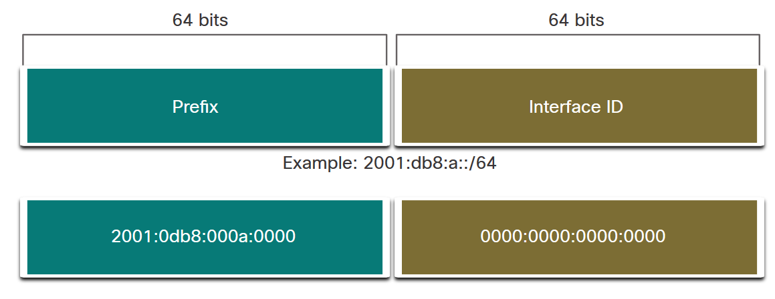
IPv6 Address Types IPv6 Prefix Length
Prefix length is represented in slash notation and is used to indicate the network portion of an IPv6 address.
The IPv6 prefix length can range from 0 to 128. The recommended IPv6 prefix length for LANs and most other types of networks is /64.
Note: It is strongly recommended to use a 64-bit Interface ID for most networks. This is because stateless address autoconfiguration (SLAAC) uses 64 bits for the Interface ID. It also makes subnetting easier to create and manage.
Notes:
12 – IPv6 Addressing
12.3 – IPv6 Address Types
12.3.2 – IPv6 Prefix Length

Slide 52
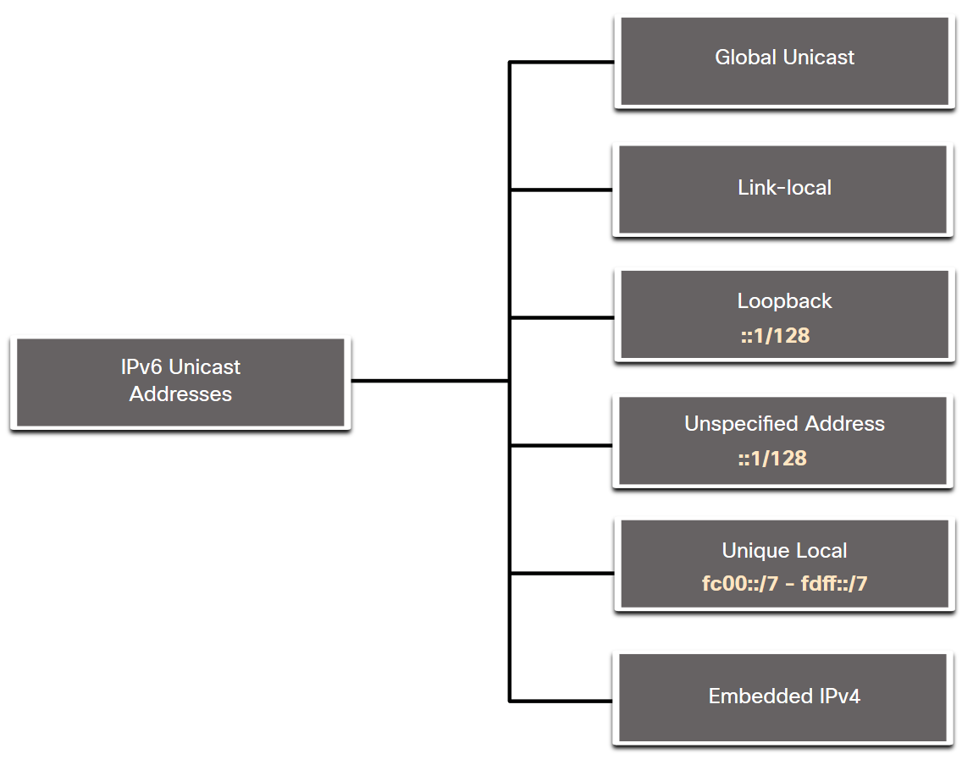
IPv6 Address Types Types of IPv6 Unicast Addresses
Unlike IPv4 devices that have only a single address, IPv6 addresses typically have two unicast addresses:
Global Unicast Address (GUA) – This is similar to a public IPv4 address. These are globally unique, internet-routable addresses.
Link-local Address (LLA) - Required for every IPv6-enabled device and used to communicate with other devices on the same local link. LLAs are not routable and are confined to a single link.
::/128
Notes:
12 – IPv6 Addressing
12.3 – IPv6 Address Types
12.3.3 – Types of IPv6 unicast Addresses

Slide 53
IPv6 Address Types A Note About the Unique Local Address
The IPv6 unique local addresses (range fc00::/7 to fdff::/7) have some similarity to RFC 1918 private addresses for IPv4, but there are significant differences:
Unique local addresses are used for local addressing within a site or between a limited number of sites.
Unique local addresses can be used for devices that will never need to access another network.
Unique local addresses are not globally routed or translated to a global IPv6 address.
Note: Many sites use the private nature of RFC 1918 addresses to attempt to secure or hide their network from potential security risks. This was never the intended use of ULAs.
Notes:
12 – IPv6 Addressing
12.3 – IPv6 Address Types
12.3.4 – A Note About the Unique Local Address

Slide 54
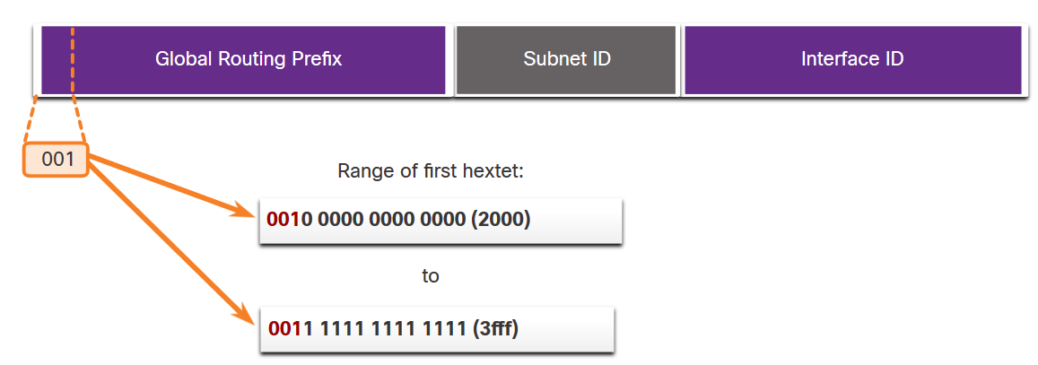
IPv6 Address Types IPv6 GUA
IPv6 global unicast addresses (GUAs) are globally unique and routable on the IPv6 internet.
Currently, only GUAs with the first three bits of 001 or 2000::/3 are being assigned.
Currently available GUAs begins with a decimal 2 or a 3 (This is only 1/8th of the total available IPv6 address space).
Notes:
12 – IPv6 Addressing
12.3 – IPv6 Address Types
12.3.5 – IPv6 GUA

Slide 55
IPv6 Address Types IPv6 GUA Structure
Global Routing Prefix:
The global routing prefix is the prefix, or network, portion of the address that is assigned by the provider, such as an ISP, to a customer or site. The global routing prefix will vary depending on ISP policies.
Subnet ID:
The Subnet ID field is the area between the Global Routing Prefix and the Interface ID. The Subnet ID is used by an organization to identify subnets within its site.
Interface ID:
The IPv6 interface ID is equivalent to the host portion of an IPv4 address. It is strongly recommended that in most cases /64 subnets should be used, which creates a 64-bit interface ID.
Note: IPv6 allows the all-0s and all-1s host addresses can be assigned to a device. The all-0s address is reserved as a Subnet-Router anycast address, and should be assigned only to routers.
Notes:
12 – IPv6 Addressing
12.3 – IPv6 Address Types
12.3.5 – IPv6 GUA Structure

Slide 56
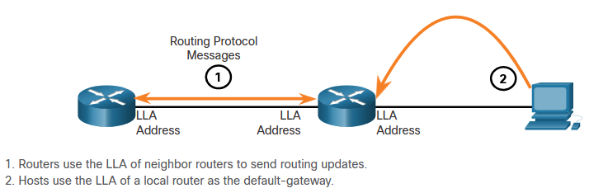
IPv6 Address Types IPv6 LLA
An IPv6 link-local address (LLA) enables a device to communicate with other IPv6-enabled devices on the same link and only on that link (subnet).
Packets with a source or destination LLA cannot be routed.
Every IPv6-enabled network interface must have an LLA.
If an LLA is not configured manually on an interface, the device will automatically create one.
IPv6 LLAs are in the fe80::/10 to FEBF::/10 range.
Notes:
12 – IPv6 Addressing
12.3 – IPv6 Address Types
12.3.6 – IPv6 LLA
12.3.7 – Check Your Understanding – IPv6 Address Types

Slide 57
12.4 GUA and LLA Static Configuration
Notes:
12-IPv6 Addressing
12.4- GUA and LLA Static Configuration

Slide 58
GUA and LLA Static Configuration Static GUA Configuration on a Router
Most IPv6 configuration and verification commands in the Cisco IOS are similar to their IPv4 counterparts. In many cases, the only difference is the use of ipv6 in place of ip within the commands.
The command to configure an IPv6 GUA on an interface is: ipv6 address ipv6-address/prefix-length.
The example shows commands to configure a GUA on the G0/0/0 interface on R1:
R1(config)# interface gigabitethernet 0/0/0
R1(config-if)# ipv6 address 2001:db8:acad:1::1/64
R1(config-if)# no shutdown
R1(config-if)# exit
Notes:
12 – IPv6 Addressing
12.4 – GUA and LLA Static Configuration
12.4.1 – Static GUA Configuration on a Router

Slide 59
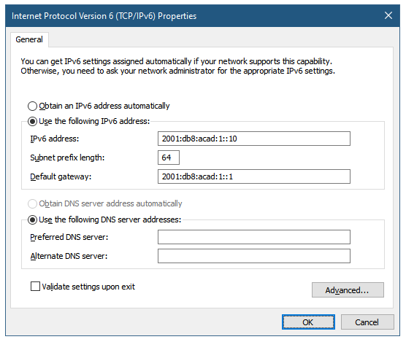
GUA and LLA Static Configuration Static GUA Configuration on a Windows Host
Manually configuring the IPv6 address on a host is similar to configuring an IPv4 address.
The GUA or LLA of the router interface can be used as the default gateway. Best practice is to use the LLA.
Note: When DHCPv6 or SLAAC is used, the LLA of the router will automatically be specified as the default gateway address.
Notes:
12 – IPv6 Addressing
12.4 – GUA and LLA Static Configuration
12.4.2 – Static GUA Configuration on a Windows Host

Slide 60
GUA and LLA Static Configuration Static GUA Configuration of a Link-Local Unicast Address
Configuring the LLA manually lets you create an address that is recognizable and easier to remember.
LLAs can be configured manually using the ipv6 address ipv6-link-local-address link-local command.
The example shows commands to configure a LLA on the G0/0/0 interface on R1
R1(config)# interface gigabitethernet 0/0/0
R1(config-if)# ipv6 address fe80::1:1 link-local
R1(config-if)# no shutdown
R1(config-if)# exit
Note: The same LLA can be configured on each link as long as it is unique on that link. Common practice is to create a different LLA on each interface of the router to make it easy to identify the router and the specific interface.
Notes:
12 – IPv6 Addressing
12.4 – GUA and LLA Static Configuration
12.4.3 – Static GUA Configuration of a Link-Local Unicast Address
12.4.4 – Syntax Checker – GUA and LLA Static Configuration

Slide 61
12.5 Dynamic Addressing for IPv6 GUAs
Notes:
12-IPv6 Addressing
12.5 IPv4 Dynamic Addressing for IPv6 GUAs

Slide 62
Dynamic Addressing for IPv6 GUAs RS and RA Messages
Devices obtain GUA addresses dynamically through Internet Control Message Protocol version 6 (ICMPv6) messages.
Router Solicitation (RS) messages are sent by host devices to discover IPv6 routers
Router Advertisement (RA) messages are sent by routers to inform hosts on how to obtain an IPv6 GUA and provide useful network information such as:
Network prefix and prefix length
Default gateway address
DNS addresses and domain name
The RA can provide three methods for configuring an IPv6 GUA :
SLAAC
SLAAC with stateless DHCPv6 server
Stateful DHCPv6 (no SLAAC)
Notes:
12 – IPv6 Addressing
12.5 – Dynamic Addressing for IPv6 GUAs
12.5.1 – RS and RA Messages

Slide 63
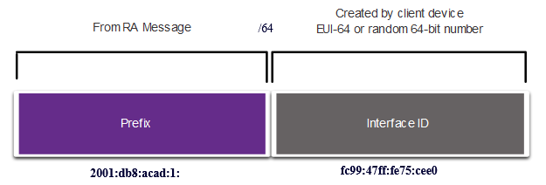
Dynamic Addressing for IPv6 GUAs Method 1: SLAAC
SLAAC allows a device to configure a GUA without the services of DHCPv6.
Devices obtain the necessary information to configure a GUA from the ICMPv6 RA messages of the local router.
The prefix is provided by the RA and the device uses either the EUI-64 or random generation method to create an interface ID.
Notes:
12 – IPv6 Addressing
12.5 – Dynamic Addressing for IPv6 GUAs
12.5.2 – Method 1: SLAAC

Slide 64
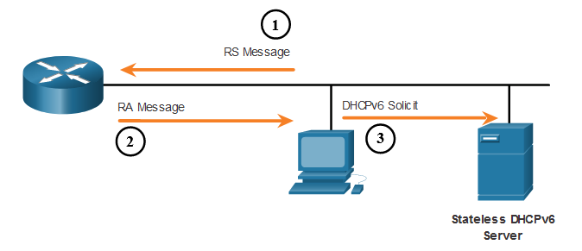
Dynamic Addressing for IPv6 GUAs Method 2: SLAAC and Stateless DHCP
An RA can instruct a device to use both SLAAC and stateless DHCPv6.
The RA message suggests devices use the following:
SLAAC to create its own IPv6 GUA
The router LLA, which is the RA source IPv6 address, as the default gateway address
A stateless DHCPv6 server to obtain other information such as a DNS server address and a domain name
Notes:
12 – IPv6 Addressing
12.5 – Dynamic Addressing for IPv6 GUAs
12.5.3 – Method 2: SLAAC and Stateless DHCP

Slide 65
Dynamic Addressing for IPv6 GUAs Method 3: Stateful DHCPv6
An RA can instruct a device to use stateful DHCPv6 only.
Stateful DHCPv6 is similar to DHCP for IPv4. A device can automatically receive a GUA, prefix length, and the addresses of DNS servers from a stateful DHCPv6 server.
The RA message suggests devices use the following:
The router LLA, which is the RA source IPv6 address, for the default gateway address.
A stateful DHCPv6 server to obtain a GUA, DNS server address, domain name and other necessary information.
Notes:
12 – IPv6 Addressing
12.5 – Dynamic Addressing for IPv6 GUAs
12.5.4 – Method 3: Stateful DHCPv6

Slide 66
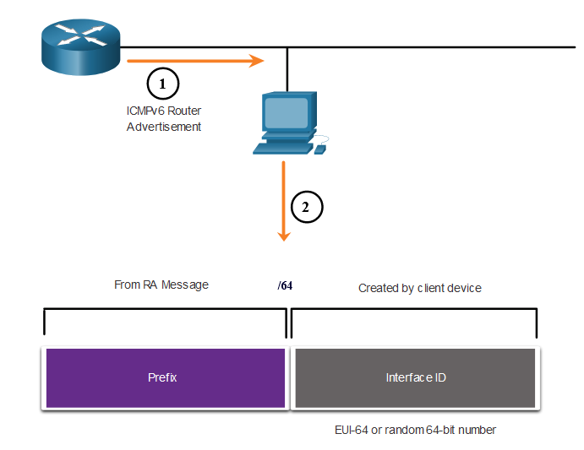
Dynamic Addressing for IPv6 GUAs EUI-64 Process vs. Randomly Generated
When the RA message is either SLAAC or SLAAC with stateless DHCPv6, the client must generate its own interface ID.
The interface ID can be created using the EUI-64 process or a randomly generated 64-bit number.
Notes:
12 – IPv6 Addressing
12.5 – Dynamic Addressing for IPv6 GUAs
12.5.5 – EUI-64 Process vs. Randomly Generated

Slide 67
Dynamic Addressing for IPv6 GUAs EUI-64 Process
The IEEE defined the Extended Unique Identifier (EUI) or modified EUI-64 process which performs the following:
A 16 bit value of fffe (in hexadecimal) is inserted into the middle of the 48-bit Ethernet MAC address of the client.
The 7th bit of the client MAC address is reversed from binary 0 to 1.
Example:
48-bit MAC | fc:99:47:75:ce:e0
EUI-64 Interface ID | fe:99:47:ff:fe:75:ce:e0
Notes:
12 – IPv6 Addressing
12.5 – Dynamic Addressing for IPv6 GUAs
12.5.6 – EUI-64 Process

Slide 68
Dynamic Addressing for IPv6 GUAs Randomly Generated Interface IDs
Depending upon the operating system, a device may use a randomly generated interface ID instead of using the MAC address and the EUI-64 process.
Beginning with Windows Vista, Windows uses a randomly generated interface ID instead of one created with EUI-64.
C:\> ipconfig
Windows IP Configuration
Ethernet adapter Local Area Connection:
Connection-specific DNS Suffix . :
IPv6 Address. . . . . . . . . . . : 2001:db8:acad:1:50a5:8a35:a5bb:66e1
Link-local IPv6 Address . . . . . : fe80::50a5:8a35:a5bb:66e1
Default Gateway . . . . . . . . . : fe80::1
C:\>
Note: To ensure the uniqueness of any IPv6 unicast address, the client may use a process known as Duplicate Address Detection (DAD). This is similar to an ARP request for its own address. If there is no reply, then the address is unique.
Notes:
12 – IPv6 Addressing
12.5 – Dynamic Addressing for IPv6 GUAs
12.5.7 – Randomly Generated Interface IDs
12.5.8 – Check Your Understanding – Dynamic Address for IPv6 GUAs

Slide 69
12.6 Dynamic Addressing for IPv6 LLAs
Notes:
12-IPv6 Addressing
12.6 IPv4 Dynamic Addressing for IPv6 LLAs

Slide 70
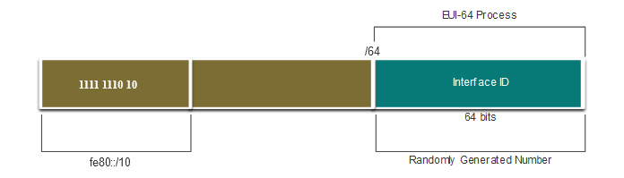
Dynamic Addressing for IPv6 LLAs Dynamic LLAs
All IPv6 interfaces must have an IPv6 LLA.
Like IPv6 GUAs, LLAs can be configured dynamically.
The figure shows the LLA is dynamically created using the fe80::/10 prefix and the interface ID using the EUI-64 process, or a randomly generated 64-bit number.
Notes:
12 – IPv6 Addressing
12.6 – Dynamic Addressing for IPv6 LLAs
12.6.1 – Dynamic LLAs

Slide 71
Dynamic Addressing for IPv6 LLAs Dynamic LLAs on Windows
Operating systems, such as Windows, will typically use the same method for both a SLAAC-created GUA and a dynamically assigned LLA.
EUI-64 Generated Interface ID:
C:\> ipconfig
Windows IP Configuration
Ethernet adapter Local Area Connection:
Connection-specific DNS Suffix . :
IPv6 Address. . . . . . . . . . . : 2001:db8:acad:1:fc99:47ff:fe75:cee0
Link-local IPv6 Address . . . . . : fe80::fc99:47ff:fe75:cee0
Default Gateway . . . . . . . . . : fe80::1
C:\>
Random 64-bit Generated Interface ID:
C:\> ipconfig
Windows IP Configuration
Ethernet adapter Local Area Connection:
Connection-specific DNS Suffix . :
IPv6 Address. . . . . . . . . . . : 2001:db8:acad:1:50a5:8a35:a5bb:66e1
Link-local IPv6 Address . . . . . : fe80::50a5:8a35:a5bb:66e1
Default Gateway . . . . . . . . . : fe80::1
C:\>
Notes:
12 – IPv6 Addressing
12.6 – Dynamic Addressing for IPv6 LLAs
12.6.2 – Dynamic LLAs on Windows

Slide 72
Dynamic Addressing for IPv6 LLAs Dynamic LLAs on Cisco Routers
Cisco routers automatically create an IPv6 LLA whenever a GUA is assigned to the interface. By default, Cisco IOS routers use EUI-64 to generate the interface ID for all LLAs on IPv6 interfaces.
Here is an example of a LLA dynamically configured on the G0/0/0 interface of R1:
R1# show interface gigabitEthernet 0/0/0
GigabitEthernet0/0/0 is up, line protocol is up
Hardware is ISR4221-2x1GE, address is 7079.b392.3640 (bia 7079.b392.3640)
(Output omitted)
R1# show ipv6 interface brief
GigabitEthernet0/0/0 [up/up]
FE80::7279:B3FF:FE92:3640
2001:DB8:ACAD:1::1
Notes:
12 – IPv6 Addressing
12.6 – Dynamic Addressing for IPv6 LLAs
12.6.3 – Dynamic LLAs on Cisco Routers

Slide 73
Dynamic Addressing for IPv6 LLAs Verify IPv6 Address Configuration
Cisco routers automatically create an IPv6 LLA whenever a GUA is assigned to the interface. By default, Cisco IOS routers use EUI-64 to generate the interface ID for all LLAs on IPv6 interfaces.
Here is an example of a LLA dynamically configured on the G0/0/0 interface of R1:
R1# show interface gigabitEthernet 0/0/0
GigabitEthernet0/0/0 is up, line protocol is up
Hardware is ISR4221-2x1GE, address is 7079.b392.3640 (bia 7079.b392.3640)
(Output omitted)
R1# show ipv6 interface brief
GigabitEthernet0/0/0 [up/up]
FE80::7279:B3FF:FE92:3640
2001:DB8:ACAD:1::1
Notes:
12 – IPv6 Addressing
12.6 – Dynamic Addressing for IPv6 LLAs
12.6.4 – Verify IPv6 Address Configuration
12.6.5 – Syntax Checker – Verify IPv6 Address Configuration

Slide 74
12.7 IPv6 Multicast Addresses
Notes:
12-IPv6 Addressing
12.7 IPv4 Multicast Addresses

Slide 75
IPv6 Multicast Addresses Assigned IPv6 Multicast Addresses
IPv6 multicast addresses have the prefix ff00::/8. There are two types of IPv6 multicast addresses:
Well-Known multicast addresses
Solicited node multicast addresses
Note: Multicast addresses can only be destination addresses and not source addresses.
Notes:
12 – IPv6 Addressing
12.7 – IPv6 Multicast Addresses
12.7.1 – Assigned IPv6 Multicast Addresses

Slide 76
IPv6 Multicast Addresses Well-Known IPv6 Multicast Addresses
Well-known IPv6 multicast addresses are assigned and are reserved for predefined groups of devices.
There are two common IPv6 Assigned multicast groups:
ff02::1 All-nodes multicast group - This is a multicast group that all IPv6-enabled devices join. A packet sent to this group is received and processed by all IPv6 interfaces on the link or network.
ff02::2 All-routers multicast group - This is a multicast group that all IPv6 routers join. A router becomes a member of this group when it is enabled as an IPv6 router with the ipv6 unicast-routing global configuration command.
Notes:
12 – IPv6 Addressing
12.7 – IPv6 Multicast Addresses
12.7.2 – Well-Known IPv6 Multicast Addresses

Slide 77
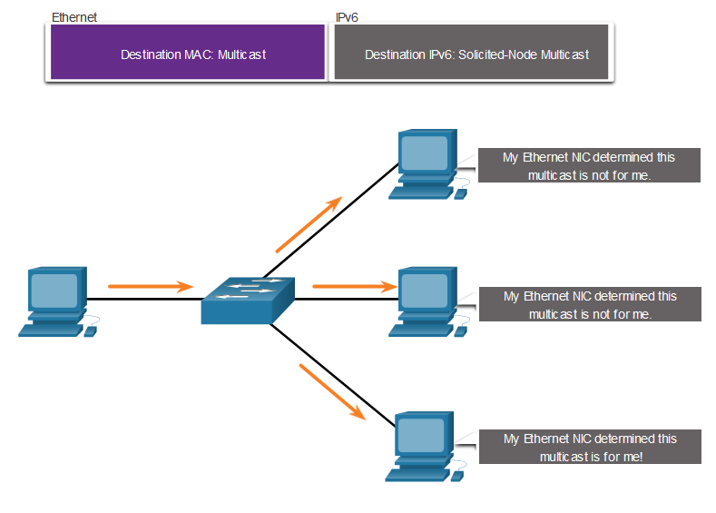
IPv6 Multicast Addresses Solicited-Node IPv6 Multicast
A solicited-node multicast address is similar to the all-nodes multicast address.
A solicited-node multicast address is mapped to a special Ethernet multicast address.
The Ethernet NIC can filter the frame by examining the destination MAC address without sending it to the IPv6 process to see if the device is the intended target of the IPv6 packet.
Notes:
12 – IPv6 Addressing
12.7 – IPv6 Multicast Addresses
12.7.3 – Solicited-Node IPv6 Multicast Address
12.7.4 – Lab – Identify IPv6 Addresses

Slide 78
12.8 Subnet an IPv6 Network
Notes:
12-IPv6 Addressing
12.8 Subnet an IPv6 Network

Slide 79
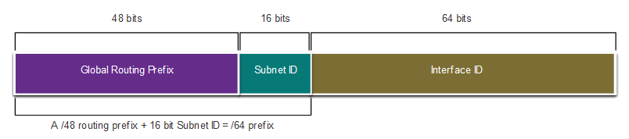
Subnet an IPv6 Network Subnet Using the Subnet ID
IPv6 was designed with subnetting in mind.
A separate subnet ID field in the IPv6 GUA is used to create subnets.
The subnet ID field is the area between the Global Routing Prefix and the interface ID.
Notes:
12 – IPv6 Addressing
12.8 – Subnet an IPv6 Network
12.8.1 – Subnet Using the Subnet ID

Slide 80
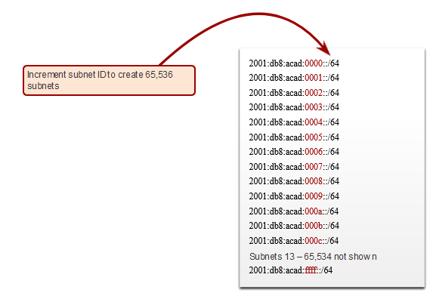
Subnet an IPv6 Network IPv6 Subnetting Example
Given the 2001:db8:acad::/48 global routing prefix with a 16 bit subnet ID.
Allows 65,536 /64 subnets
The global routing prefix is the same for all subnets.
Only the subnet ID hextet is incremented in hexadecimal for each subnet.
Notes:
12 – IPv6 Addressing
12.8 – Subnet an IPv6 Network
12.8.2 – IPv6 Subnetting Example

Slide 81
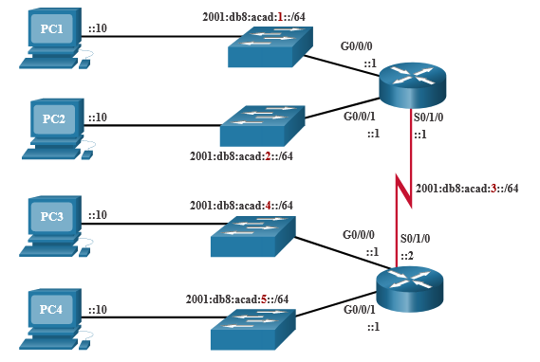
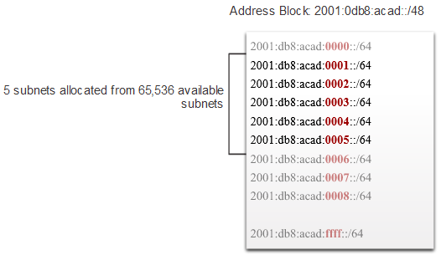
Subnet an IPv6 Network IPv6 Subnet Allocation
The example topology requires five subnets, one for each LAN as well as for the serial link between R1 and R2.
The five IPv6 subnets were allocated, with the subnet ID field 0001 through 0005. Each /64 subnet will provide more addresses than will ever be needed.
Notes:
12 – IPv6 Addressing
12.8 – Subnet an IPv6 Network
12.8.3 – IPv6 Subnet Allocation

Slide 82
Subnet an IPv6 Network Router Configured with IPv6 Subnets
The example shows that each of the router interfaces on R1 has been configured to be on a different IPv6 subnet.
R1(config)# interface gigabitethernet 0/0/0
R1(config-if)# ipv6 address 2001:db8:acad:1::1/64
R1(config-if)# no shutdown
R1(config-if)# exit
R1(config)# interface gigabitethernet 0/0/1
R1(config-if)# ipv6 address 2001:db8:acad:2::1/64
R1(config-if)# no shutdown
R1(config-if)# exit
R1(config)# interface serial 0/1/0
R1(config-if)# ipv6 address 2001:db8:acad:3::1/64
R1(config-if)# no shutdown
Notes:
12 – IPv6 Addressing
12.8 – Subnet an IPv6 Network
12.8.4 – Router Configured with IPv6 Subnets
12.8.5 – Check Your Understanding – Subnet an IPv6 Network

Slide 83
Module 13: ICMP
Introduction of Networks v7.0 (ITN)
Notes:
Cisco Networking Academy Program
Introduction of Networks v7.0 (ITN)
Module 13: ICMP

Slide 84
13.1 ICMP Messages
Notes:
13 – ICMP
13.1 – ICMP Messages

Slide 85
ICMP Messages ICMPv4 and ICMPv6 Messages
Internet Control Message Protocol (ICMP) provides feedback about issues related to the processing of IP packets under certain conditions.
ICMPv4 is the messaging protocol for IPv4. ICMPv6 is the messaging protocol for IPv6 and includes additional functionality.
The ICMP messages common to both ICMPv4 and ICMPv6 include:
Host reachability
Destination or Service Unreachable
Time exceeded
Note: ICMPv4 messages are not required and are often not allowed within a network for security reasons.
Notes:
13 – ICMP
13.1 – ICMP Messages
13.1.1 – ICMPv4 and ICMPv6 Messages

Slide 86
ICMP Messages Host Reachability
ICMP Echo Message can be used to test the reachability of a host on an IP network.
In the example:
The local host sends an ICMP Echo Request to a host.
If the host is available, the destination host responds with an Echo Reply.
Notes:
13 – ICMP
13.1 – ICMP Messages
13.1.2 – Host Reachability

Slide 87
ICMP Messages Destination or Service Unreachable
An ICMP Destination Unreachable message can be used to notify the source that a destination or service is unreachable.
The ICMP message will include a code indicating why the packet could not be delivered.
A few Destination Unreachable codes for ICMPv4 are as follows:
0 - Net unreachable
1 - Host unreachable
2 - Protocol unreachable
3 - Port unreachable
A few Destination Unreachable codes for ICMPv6 are as follows:
0 - No route to destination
1 - Communication with the destination is administratively prohibited (e.g., firewall)
2 – Beyond scope of the source address
3 - Address unreachable
4 - Port unreachable
Note: ICMPv6 has similar but slightly different codes for Destination Unreachable messages.
Notes:
13 – ICMP
13.1 – ICMP Messages
13.1.3 – Destination or Service Unreachable

Slide 88
ICMP Messages Time Exceeded
When the Time to Live (TTL) field in a packet is decremented to 0, an ICMPv4 Time Exceeded message will be sent to the source host.
ICMPv6 also sends a Time Exceeded message. Instead of the IPv4 TTL field, ICMPv6 uses the IPv6 Hop Limit field to determine if the packet has expired.
Note: Time Exceeded messages are used by the traceroute tool.
Notes:
13 – ICMP
13.1 – ICMP Messages
13.1.4 – Time Exceeded

Slide 89
ICMP Messages ICMPv6 Messages
ICMPv6 has new features and improved functionality not found in ICMPv4, including four new protocols as part of the Neighbor Discovery Protocol (ND or NDP).
Messaging between an IPv6 router and an IPv6 device, including dynamic address allocation are as follows:
Router Solicitation (RS) message
Router Advertisement (RA) message
Messaging between IPv6 devices, including duplicate address detection and address resolution are as follows:
Neighbor Solicitation (NS) message
Neighbor Advertisement (NA) message
Note: ICMPv6 ND also includes the redirect message, which has a similar function to the redirect message used in ICMPv4.
Notes:
13 – ICMP
13.1 – ICMP Messages
13.1.5 – ICMPv6 Messages

Slide 90
ICMP Messages ICMPv6 Messages (RA)
RA messages are sent by IPv6-enabled routers every 200 seconds to provide addressing information to IPv6-enabled hosts.
RA message can include addressing information for the host such as the prefix, prefix length, DNS address, and domain name.
A host using Stateless Address Autoconfiguration (SLAAC) will set its default gateway to the link-local address of the router that sent the RA.
Notes:
13 – ICMP
13.1 – ICMP Messages
13.1.5 – ICMPv6 Messages (Cont.)

Slide 91
ICMP Messages ICMPv6 Messages (RS)
An IPv6-enabled router will also send out an RA message in response to an RS message.
In the figure, PC1 sends a RS message to determine how to receive its IPv6 address information dynamically.
R1 replies to the RS with an RA message.
PC1 sends an RS message, “Hi, I just booted up. Is there an IPv6 router on the network? I need to know how to get my IPv6 address information dynamically.”
R1 replies with an RA message. “Hi all IPv6-enabled devices. I’m R1 and you can use SLAAC to create an IPv6 global unicast address. The prefix is 2001:db8:acad:1::/64. By the way, use my link-local address fe80::1 as your default gateway."
Notes:
13 – ICMP
13.1 – ICMP Messages
13.1.5 – ICMPv6 Messages (Cont.)

Slide 92
ICMP Messages ICMPv6 Messages (DAD)
A device assigned a global IPv6 unicast or link-local unicast address, may perform duplicate address detection (DAD) to ensure that the IPv6 address is unique.
To check the uniqueness of an address, the device will send an NS message with its own IPv6 address as the targeted IPv6 address.
If another device on the network has this address, it will respond with an NA message notifying to the sending device that the address is in use.
Note: DAD is not required, but RFC 4861 recommends that DAD is performed on unicast addresses.
Notes:
13 – ICMP
13.1 – ICMP Messages
13.1.5 – ICMPv6 Messages (Cont.)

Slide 93
ICMP Messages ICMPv6 Messages (NS)
To determine the MAC address for the destination, the device will send an NS message to the solicited node address.
The message will include the known (targeted) IPv6 address. The device that has the targeted IPv6 address will respond with an NA message containing its Ethernet MAC address.
In the figure, R1 sends a NS message to 2001:db8:acad:1::10 asking for its MAC address.
Notes:
13 – ICMP
13.1 – ICMP Messages
13.1.5 – ICMPv6 Messages
13.1.6 – Check Your Understanding – ICMP Messages

Slide 94
13.2 Ping and Traceroute Tests
Notes:
13 – ICMP
13.2 – Ping and Traceroute Tests

Slide 95
Ping and Traceroute Tests Ping – Test Connectivity
The ping command is an IPv4 and IPv6 testing utility that uses ICMP echo request and echo reply messages to test connectivity between hosts and provides a summary that includes the success rate and average round-trip time to the destination.
If a reply is not received within the timeout, ping provides a message indicating that a response was not received.
It is common for the first ping to timeout if address resolution (ARP or ND) needs to be performed before sending the ICMP Echo Request.
Notes:
13 – ICMP
13.2 – Ping and Traceroute Tests
13.2.1 – Ping – Test Connectivity

Slide 96
Ping and Traceroute Tests Ping the Loopback
Ping can be used to test the internal configuration of IPv4 or IPv6 on the local host. To do this, ping the local loopback address of 127.0.0.1 for IPv4 (::1 for IPv6).
A response from 127.0.0.1 for IPv4, or ::1 for IPv6, indicates that IP is properly installed on the host.
An error message indicates that TCP/IP is not operational on the host.
Notes:
13 – ICMP
13.2 – Ping and Traceroute Tests
13.2.2 – Ping the Loopback

Slide 97
Ping and Traceroute Tests Ping the Default Gateway
The ping command can be used to test the ability of a host to communicate on the local network.
The default gateway address is most often used because the router is normally always operational.
A successful ping to the default gateway indicates that the host and the router interface serving as the default gateway are both operational on the local network.
If the default gateway address does not respond, a ping can be sent to the IP address of another host on the local network that is known to be operational.
Notes:
13 – ICMP
13.2 – Ping and Traceroute Tests
13.2.3 – Ping the Default Gateway

Slide 98
Ping and Traceroute Tests Ping a Remote Host
Ping can also be used to test the ability of a local host to communicate across an internetwork.
A local host can ping a host on a remote network. A successful ping across the internetwork confirms communication on the local network.
Note: Many network administrators limit or prohibit the entry of ICMP messages therefore, the lack of a ping response could be due to security restrictions.
Notes:
13 – ICMP
13.2 – Ping and Traceroute Tests
13.2.4 – Ping a Remote Host

Slide 99
Ping and Traceroute Tests Traceroute – Test the Path
Traceroute (tracert) is a utility that is used to test the path between two hosts and provide a list of hops that were successfully reached along that path.
Traceroute provides round-trip time for each hop along the path and indicates if a hop fails to respond. An asterisk (*) is used to indicate a lost or unreplied packet.
This information can be used to locate a problematic router in the path or may indicate that the router is configured not to reply.
Note: Traceroute makes use of a function of the TTL field in IPv4 and the Hop Limit field in IPv6 in the Layer 3 headers, along with the ICMP Time Exceeded message.
Notes:
13 – ICMP
13.2 – Ping and Traceroute Tests
13.2.5 – Traceroute – Test the Path

Slide 100
Ping and Traceroute Tests Traceroute – Test the Path (Cont.)
The first message sent from traceroute will have a TTL field value of 1. This causes the TTL to time out at the first router. This router then responds with a ICMPv4 Time Exceeded message.
Traceroute then progressively increments the TTL field (2, 3, 4...) for each sequence of messages. This provides the trace with the address of each hop as the packets time out further down the path.
The TTL field continues to be increased until the destination is reached, or it is incremented to a predefined maximum.
Notes:
13 – ICMP
13.2 – Ping and Traceroute Tests
13.2.5 – Traceroute – Test the Path (Cont.)

